Slide 1
Principles of Anatomy and Physiology
Gerard Tortora and Bryan Derrickson
Sixteenth Edition
Chapter 6
The Skeletal System: Bone Tissue
This slide deck contains animations. Please disable animations if they cause issues with your device.
Copyright ©2021 John Wiley & Sons, Inc.

Slide 2
Introduction
The purpose of the chapter is to:
Describe the functions of the skeletal system
Describe the structure of long bones
Compare and contrast endochondral and intramembranous ossification
Identify histology of compact and spongy bone tissue
Outline the roles of hormones in bone tissue and calcium homeostasis
Identify common types of fractures

Slide 3
Functions of Bone and the Skeletal System

Slide 4
Bone
Bone is an organ made up of several different tissues (bone, cartilage, dense connective tissue, adipose, and nervous tissue) working together
The entire framework of bones and their cartilages constitute the skeletal system

Slide 5
Functions of the Skeletal System
Provides support
Protects the internal organs (brain, heart, etc.)
Assists body movements (in conjunction with muscles)
Mineral homeostasis - stores and releases calcium and phosphorus
Participates in blood cell production (hemopoiesis or hematopoeisis)
Stores triglycerides in adipose cells of yellow marrow

Slide 6
Structure of Bone

Slide 7
Structure of Bone
A long bone consists of several parts:
Diaphysis (bone shaft)
2 epiphyses (both ends of the bone at the joints)
2 metaphyses (region between diaphysis and epiphysis)
Articular cartilage covering both epiphyses
Periosteum (connective tissue surrounding the diaphysis)
Medullary cavity (hollow space within diaphysis)
Endosteum (thin membrane lining the medullary cavity)

Slide 8
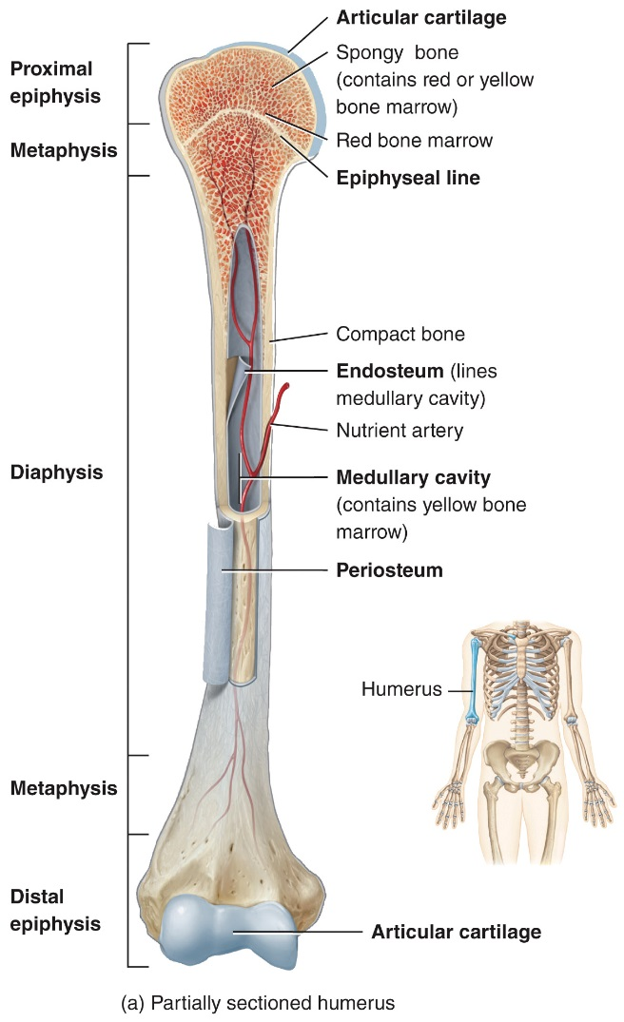
Structure of Bone

Slide 9
Histology of Bone

Slide 10
Histology of Bone
Bone contains an abundant extracellular matrix that surrounds widely separated cells
The extracellular matrix is about 15% water, 30% collagen, and 55% crystalized mineral salts
Mineral salts calcium phosphate and calcium hydroxide combine to form crystals called hydroxyapatite

Slide 11
Histology of Bone
Bone contains 4 types of cells:
Osteoprogenitor cells (bone stem cells able to differentiate into the other types of cells)
Osteoblasts (bone-building cells that secrete matrix; initiate calcification)
Osteocytes (mature bone cells)
Osteoclasts (remodel bones and cause them to release calcium; bone resorption)

Slide 12
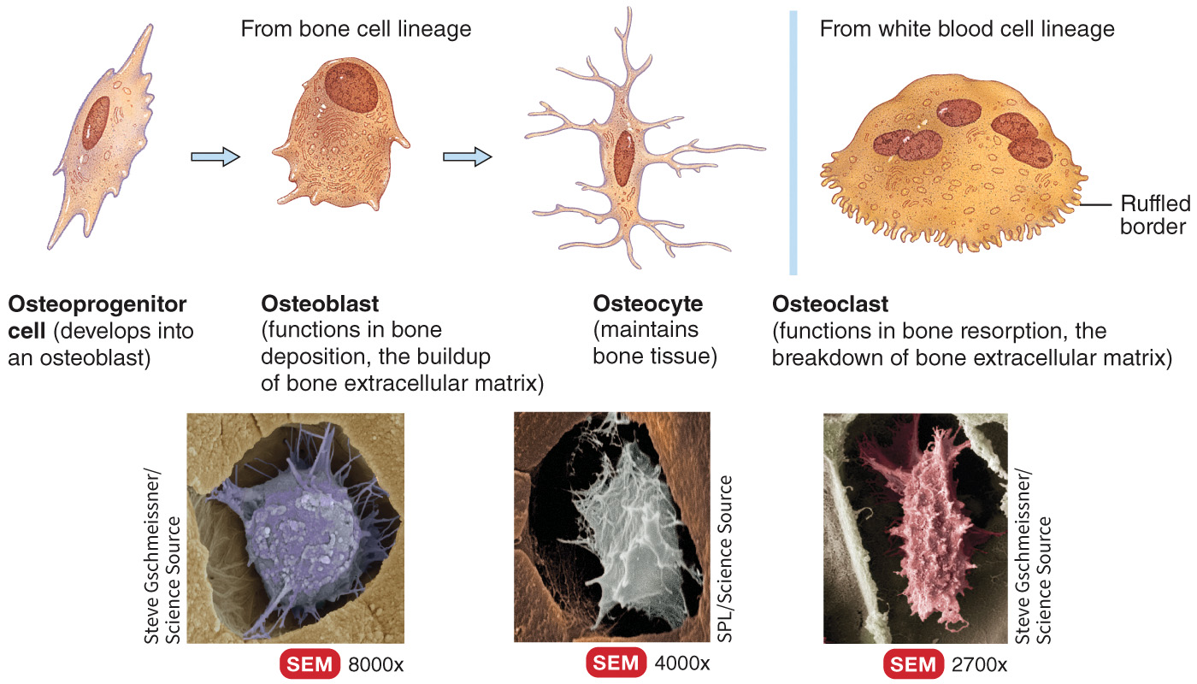
Histology of Bone

Slide 13
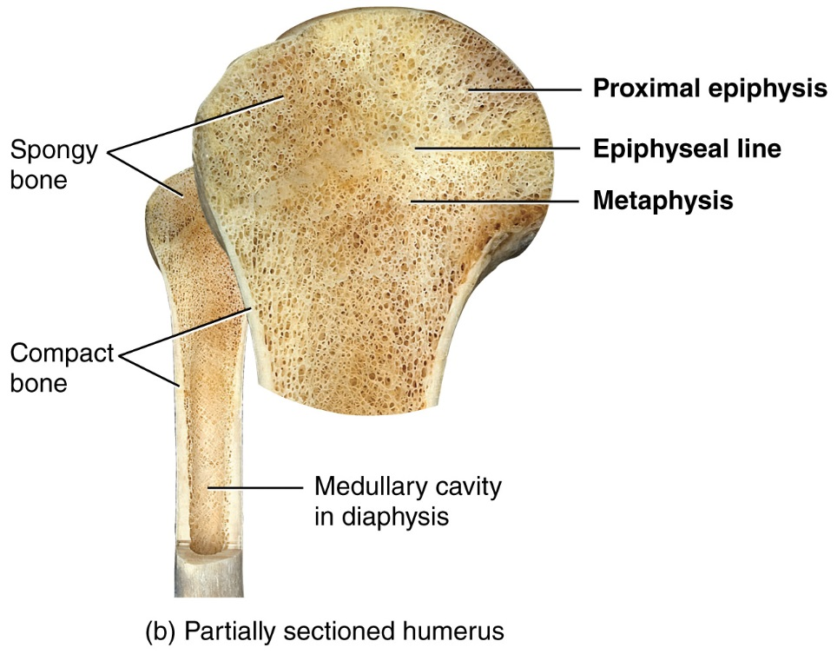
Histology of Bone
Compact bone is good at providing protection and support; strongest
Spongy bone is lightweight and provides tissue support; also called trabecular or cancellous bone

Slide 14
Histology of Bone
Compact Bone
Spongy (Cancellous) Bone
Notes:
You must be connected to the Internet and in Slideshow Mode to run this animation.

Slide 15
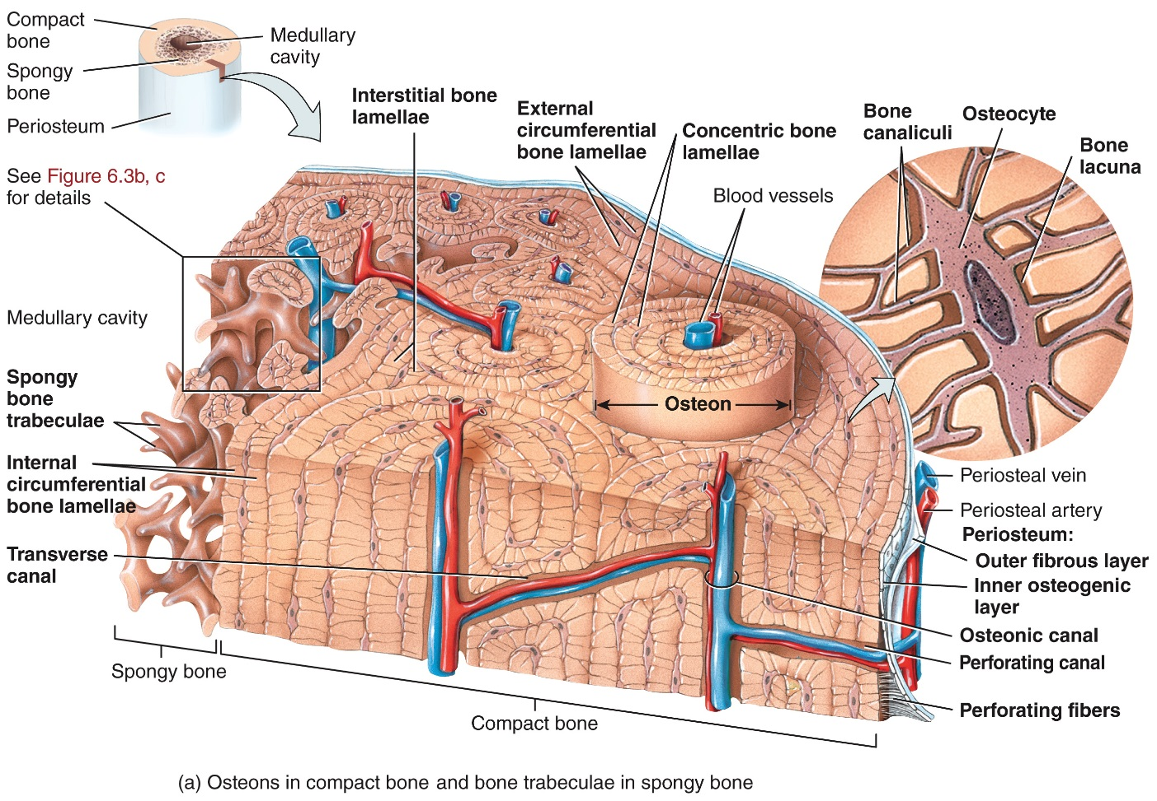
Histology of Bone

Slide 16
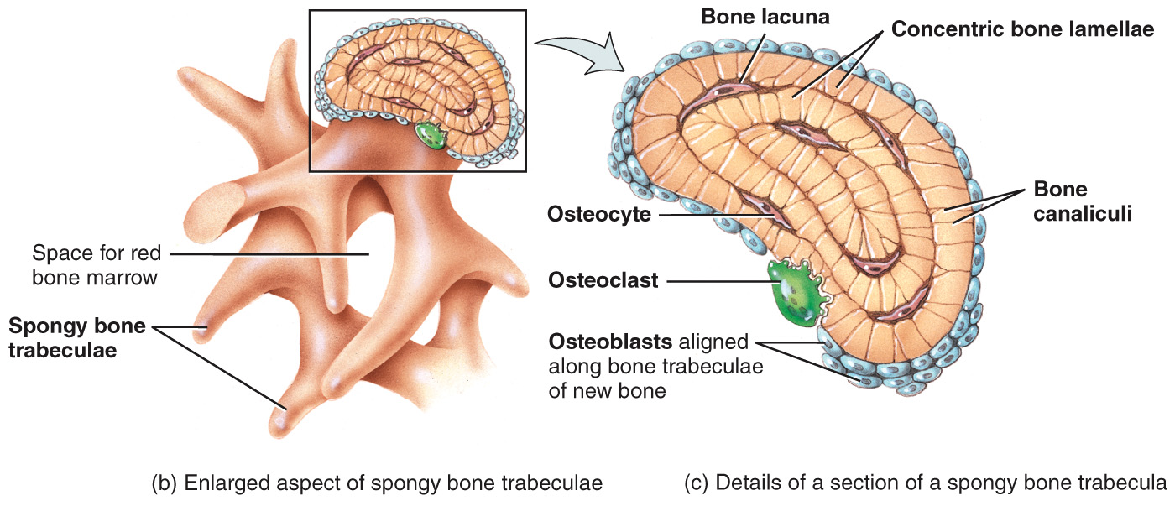
Histology of Bone

Slide 17
Blood and Nerve Supply of Bone
Periosteal arteries (accompanied by nerves) enter the diaphysis through Volkmann’s canals. They are accompanied by periosteal veins
A nutrient artery enters the center of the diaphysis through a nutrient foramen. Nutrient veins exit via the same canal
The metaphyses and epiphyses also have their own arteries and veins

Slide 18
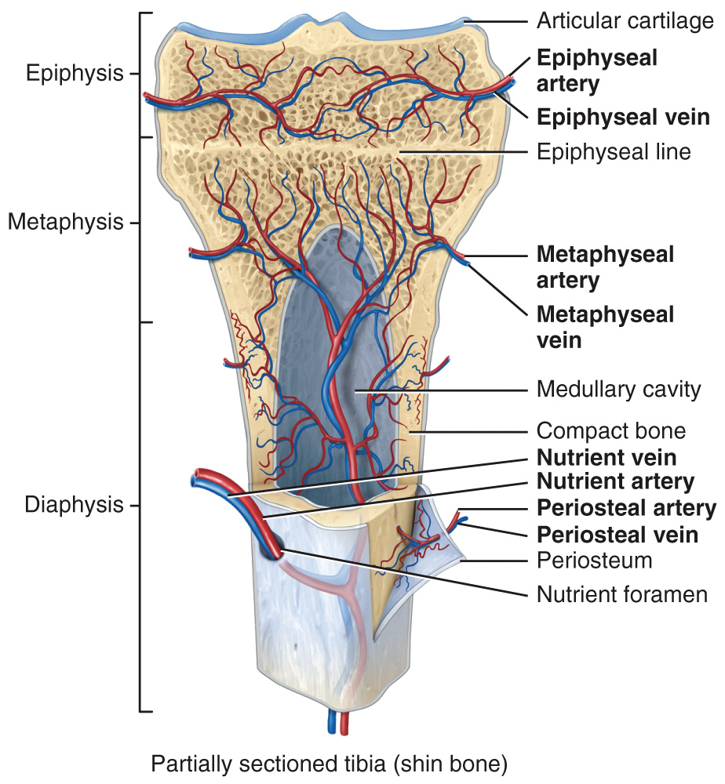
Blood and Nerve Supply of Bone

Slide 19
Bone Formation

Slide 20
Bone Formation
Ossification (osteogenesis) is the process of bone formation
Bones form in 4 situations:
During embryological and fetal development
When bones grow before adulthood
When bones remodel
When fractures heal

Slide 21
Bone Formation
Types of ossification:
Intramembranous
Occurs in flat bones when a connective tissue membrane is replaced by bone
Endochondral
Replaces cartilage with bone is the developing embryo and fetus

Slide 22
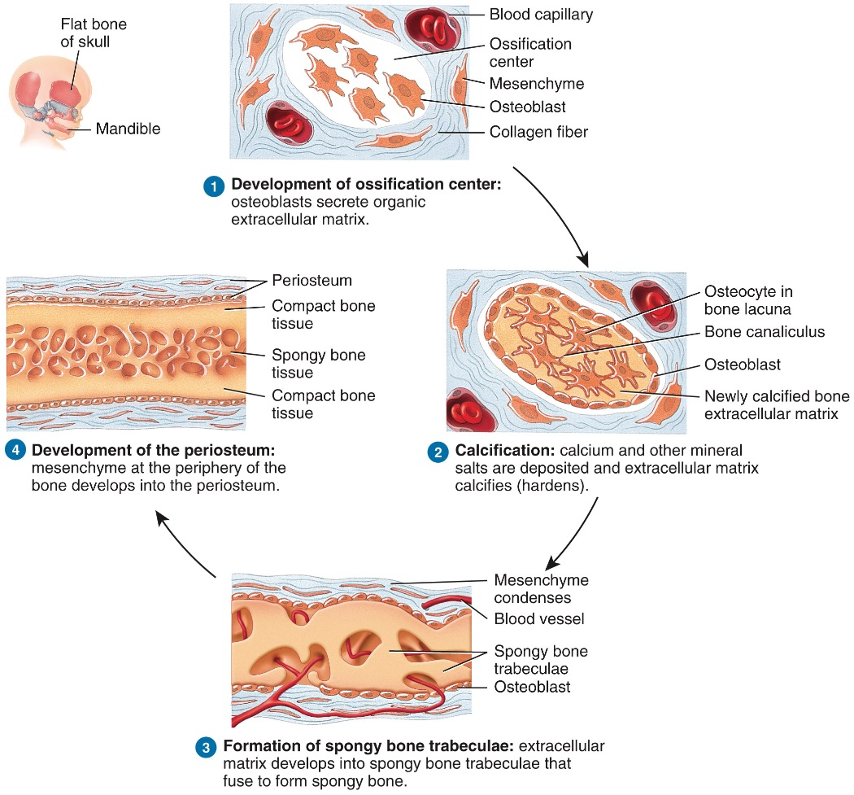
Bone Formation - Intramembranous

Slide 23
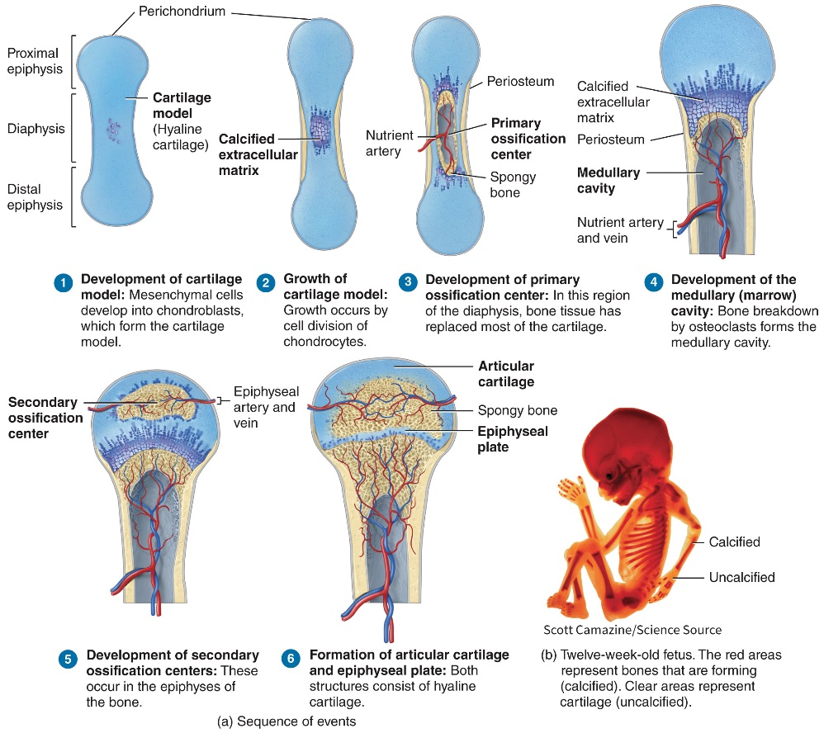
Bone Formation – Endochondral

Slide 24
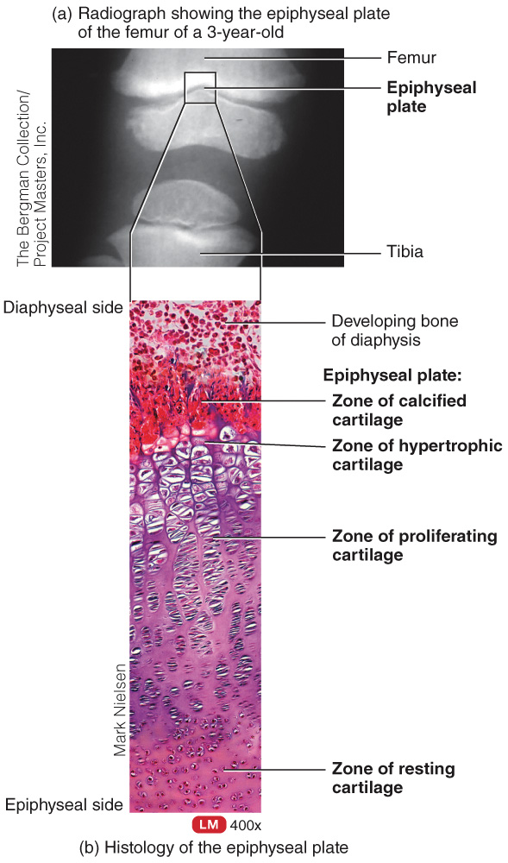
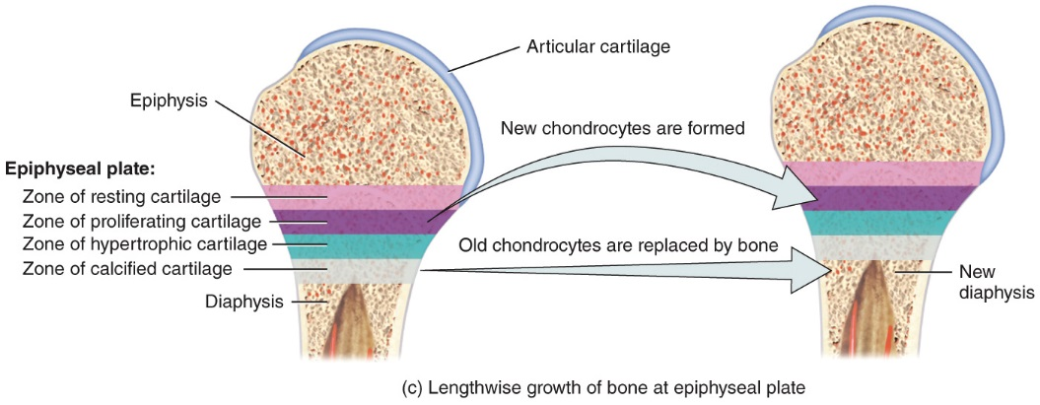
Bone Formation
Endochondral ossification also occurs in epiphyseal plates of long bones as they grow in length

Slide 25
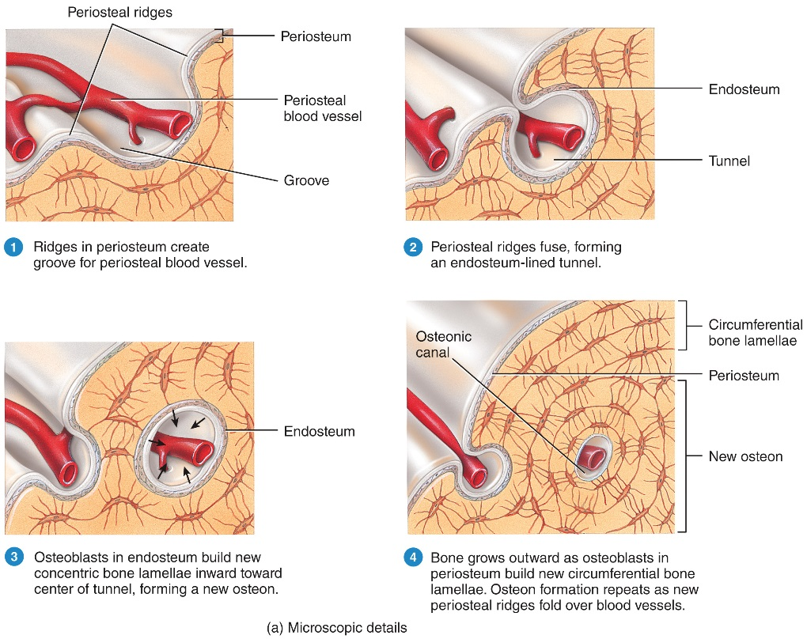
Bone Formation
Bones thicken thanks to the cooperative action of osteoblasts and osteoclasts

Slide 26
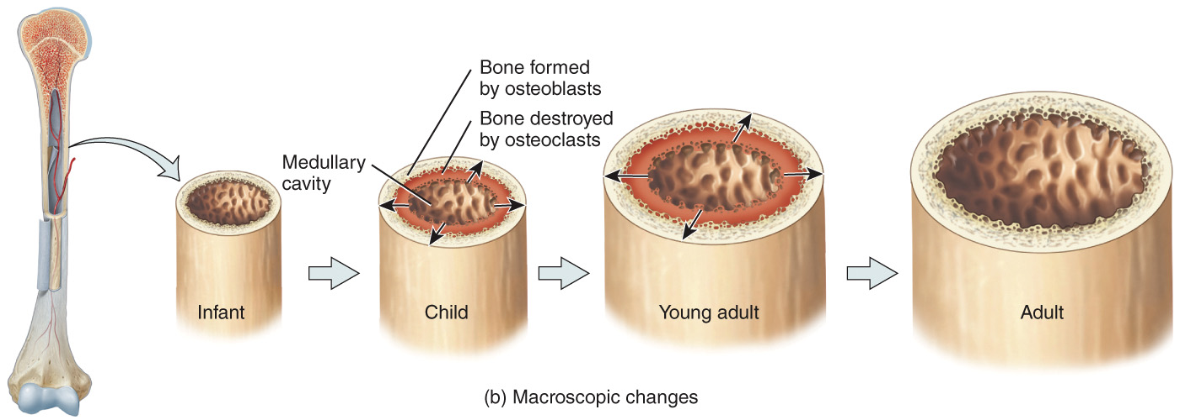
Bone Formation
As osteoblasts deposit bone on the outer surface osteoclasts widen the medullary cavity from within

Slide 27
Bone Growth and Remodeling Interactions Animation:
Bone Growth and Remodeling – necessary nutrients
Bone Growth and Remodeling – maintenance of bone thickness
Notes:
You must be connected to the Internet and in Slideshow Mode to run this animation.

Slide 28
Factors Affecting Bone Growth and Remodeling
Minerals – calcium, phosphorus, magnesium, fluoride, manganese
Vitamins – Vitamins A, C, D, K and B₁₂
Hormones – IGFs (stimulated by GH), T₃ and T₄, sex hormones (estrogen in females, testosterone in males)

Slide 29
Fracture and Repair of Bone

Slide 30
Fracture and Repair of Bone
A fracture is a break in a bone. Many different types of fractures may occur. The healing process involves 3 different phases:
The reactive phase is an early inflammatory phase
The reparative phase includes formation of a fibrocartilaginous callus first and a bony callus second
The bone remodeling phase is the last step as the bony callus is remodeled

Slide 31
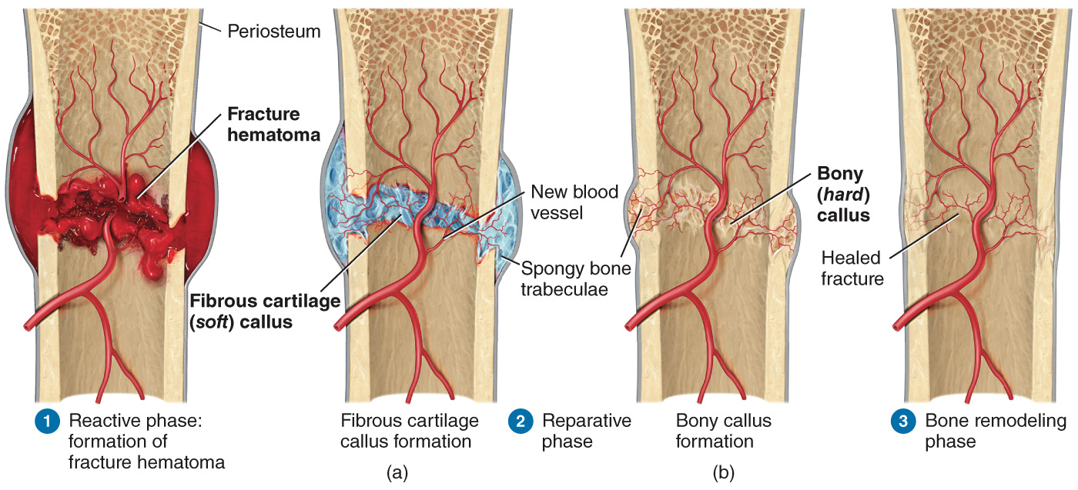
Fracture and Repair of Bone

Slide 32
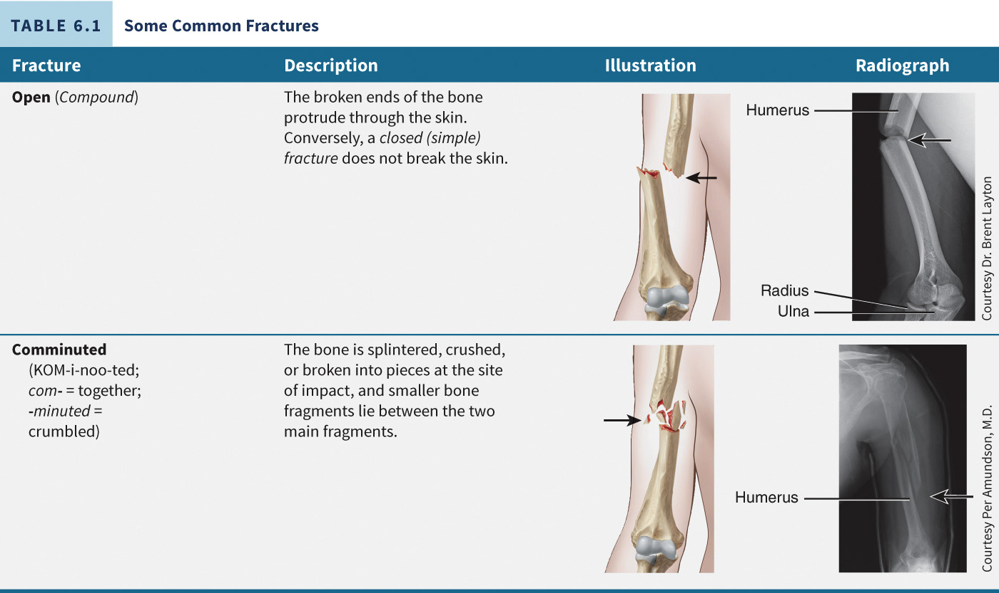
Fracture and Repair of Bone

Slide 33
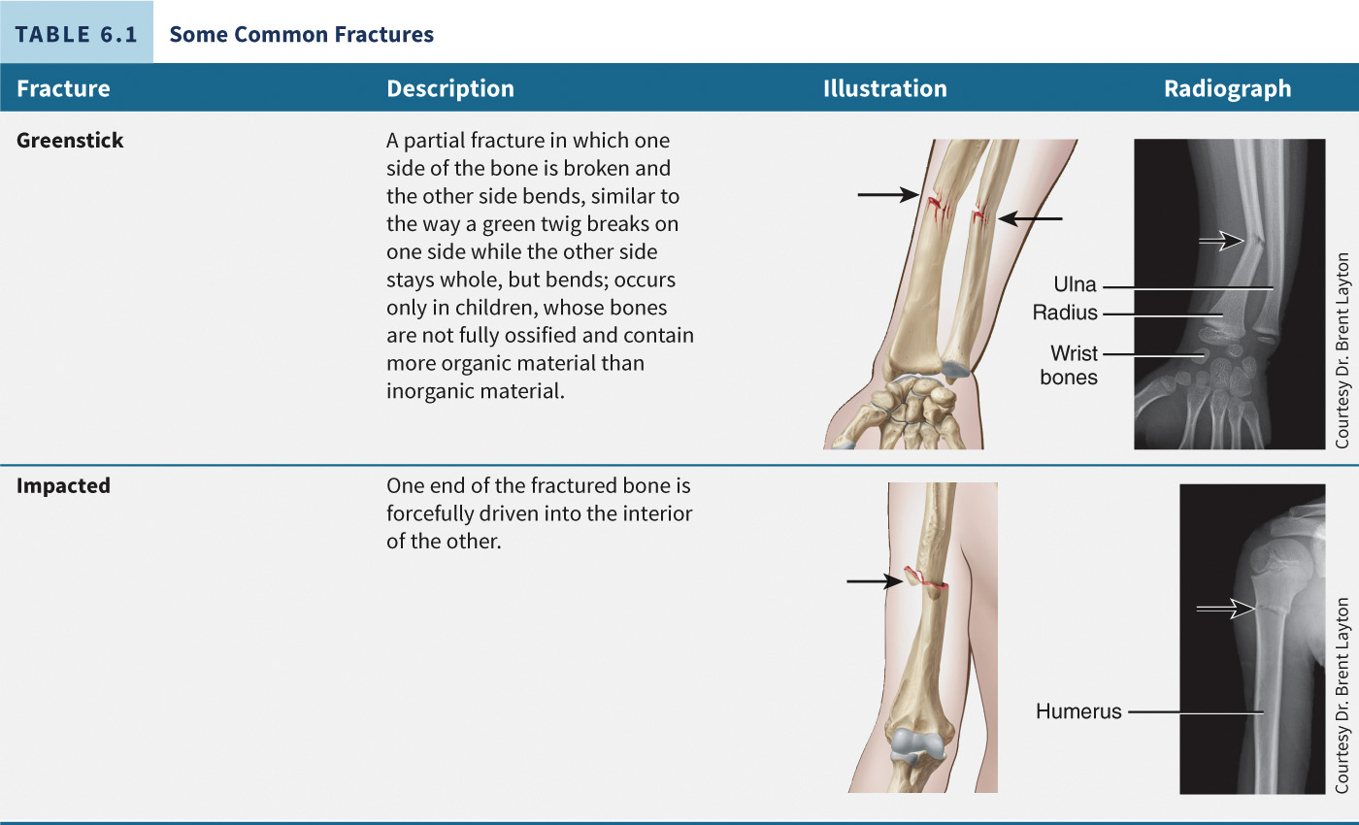
Fracture and Repair of Bone

Slide 34
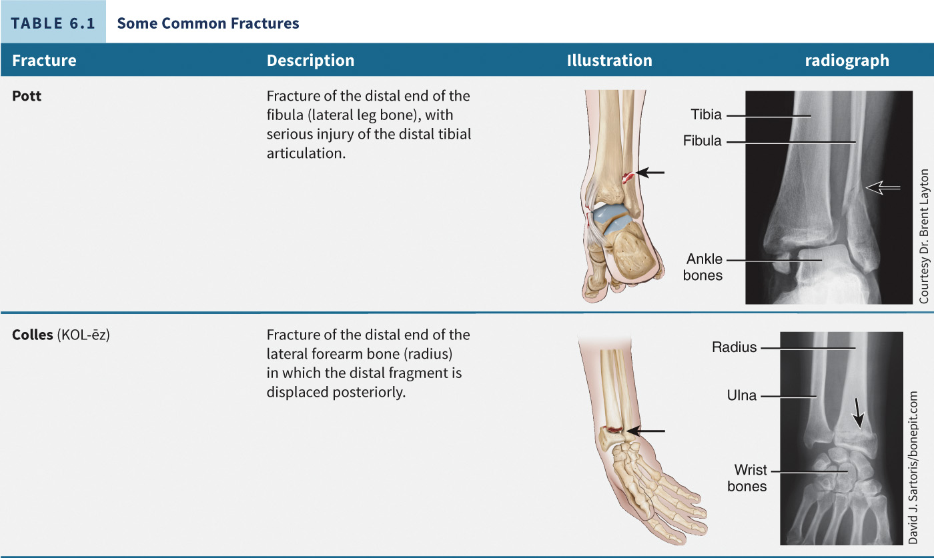
Fracture and Repair of Bone

Slide 35
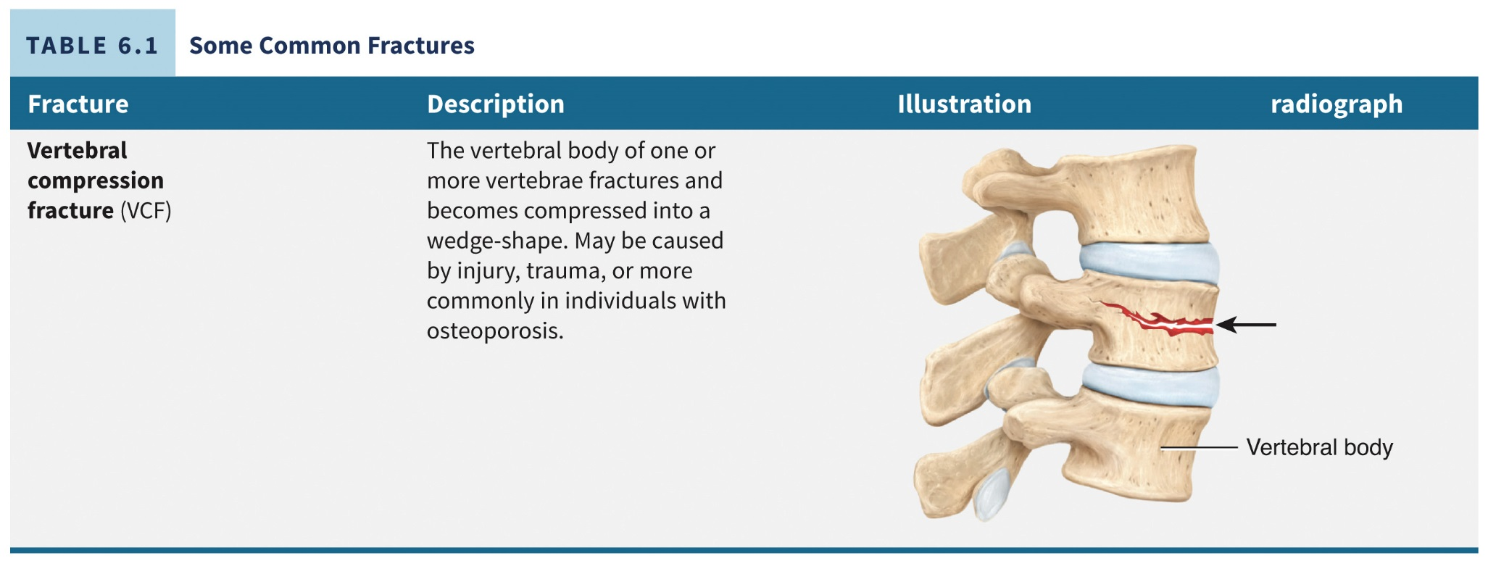
Fracture and Repair of Bone

Slide 36
Bone’s Role in Calcium Homeostasis

Slide 37
Bone’s Role in Calcium Homeostasis
Bones store 99% of the body’s calcium
Parathyroid gland secretes parathyroid hormone (PTH) when calcium levels drop
Osteoclasts are stimulated to increase bone resorption and calcium is released
PTH also stimulates the production of calcitriol by the kidneys to increase calcium absorption in the intestines

Slide 38
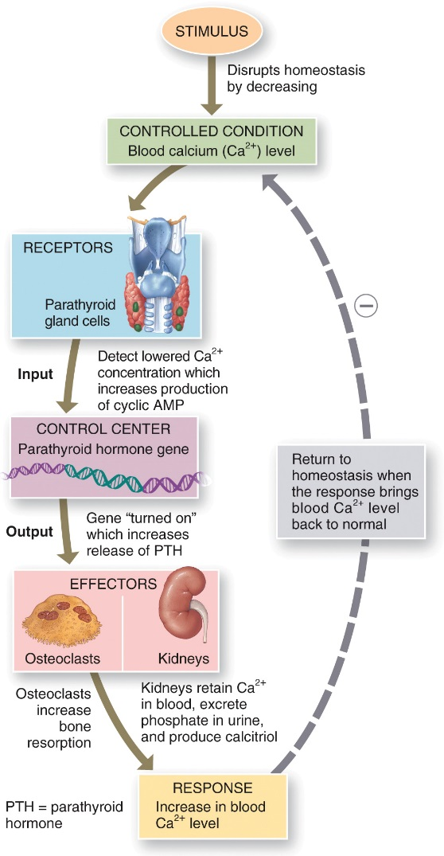
Bone’s Role in Calcium Homeostasis

Slide 39
Calcium Homeostasis Interactions Animation:
Calcium Homeostasis
Notes:
You must be connected to the Internet and in Slideshow Mode to run this animation.

Slide 40
Exercise and Aging in Bone Tissue

Slide 41
Exercise and Bone Tissue Interactions Animation:
Effect of Exercise on Bone
Notes:
You must be connected to the Internet and in Slideshow Mode to run this animation.

Slide 42
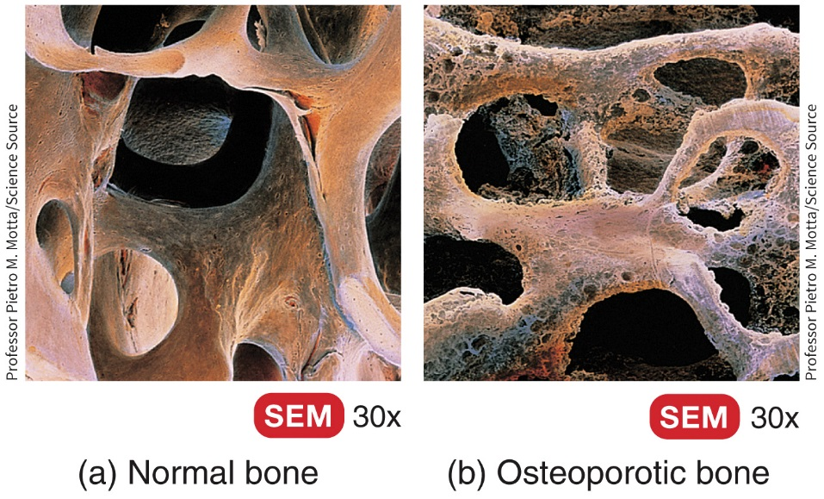
Aging and Bone Tissue
From birth through adolescence, more bone is produced than is lost during remodeling
In adults, the rates are the same
Older individuals, especially post-menopausal women, experience a decrease in bone mass when resorption outpaces deposition

Slide 43
Summary of Factors That Affect Bone Growth: Minerals
Factor | Comment
Calcium and phosphorus | Make bone extracellular matrix hard.
Magnesium | Helps form bone extracellular matrix.
Fluoride | Helps strengthen bone extracellular matrix.
Manganese | Activates enzymes involved in synthesis of bone extracellular matrix.

Slide 44
Summary of Factors That Affect Bone Growth: Vitamins
Factor | Comment
Vitamin A | Needed for the activity of osteoblasts during remodeling of bone; deficiency stunts bone growth; toxic in high doses.
Vitamin C | Needed for synthesis of collagen, the main bone protein; deficiency leads to decreased collagen production, which slows down bone growth and delays repair of broken bones.
Vitamin D | Active form (calcitriol) is produced by the kidneys; helps build bone by increasing absorption of calcium from digestive canal into blood; deficiency causes faulty calcification and slows down bone growth; may reduce the risk of osteoporosis but is toxic if taken in high doses. People who have minimal exposure to ultraviolet rays or do not take vitamin D supplements may not have sufficient vitamin D to absorb calcium. This interferes with calcium metabolism.
Vitamins K and B₁₂ | Needed for synthesis of bone proteins; deficiency leads to abnormal protein production in bone extracellular matrix and decreased bone density.

Slide 45
Summary of Factors That Affect Bone Growth: Hormones
Factor | Comment
Growth hormone (GH) | Secreted by the anterior lobe of the pituitary gland; promotes general growth of all body tissues, including bone, mainly by stimulating production of insulin-like growth factors.
Insulin-like growth factors (IGFs) | Secreted by the liver, bones, and other tissues on stimulation by growth hormone; promotes normal bone growth by stimulating osteoblasts and by increasing the synthesis of proteins needed to build new bone.
Thyroid hormones (T₃ and T₄) | Secreted by thyroid gland; promote normal bone growth by stimulating osteoblasts.
Insulin | Secreted by the pancreas; promotes normal bone growth by increasing the synthesis of bone proteins.

Slide 46
Summary of Factors That Affect Bone Growth: Hormones
Factor | Comment
Sex hormones (estrogens and testosterone) | Secreted by the ovaries in women (estrogens) and by the testes in men (testosterone); stimulate osteoblasts and promote the sudden “growth spurt” that occurs during the teenage years; shut down growth at the epiphyseal plates around age 18–21, causing lengthwise growth of bone to end; contribute to bone remodeling during adulthood by slowing bone resorption by osteoclasts and promoting bone deposition by osteoblasts.
Parathyroid hormone (PTH) | Secreted by the parathyroid glands; promotes bone resorption by osteoclasts; enhances recovery of calcium ions from urine; promotes formation of the active form of vitamin D (calcitriol).
Calcitonin (CT) | Secreted by the thyroid gland; inhibits bone resorption by osteoclasts.

Slide 47
Summary of Factors That Affect Bone Growth: Exercise and Aging
Factor | Comment
Exercise | Weight-bearing activities stimulate osteoblasts and, consequently, help build thicker, stronger bones and retard loss of bone mass that occurs as people age.
Aging | As the level of sex hormones diminishes during middle age to older adulthood, especially in women after menopause, bone resorption by osteoclasts outpaces bone deposition by osteoblasts, which leads to a decrease in bone mass and an increased risk of osteoporosis.

Slide 48
Disorders: Homeostatic Imbalances
Osteoporosis – bone resorption outpaces formation, 80% of those affected are women
Rickets and Osteomalacia – inadequate calcification of extracellular bone matrix.
Rickets affects children and leads to bowed legs and deformations in skull, rib cage or pelvis
Osteomalacia affects adults and causes painful/tender bones and fractures with minor trauma

Slide 49
Medical Terminology
Osteoarthritis – degeneration of articular cartilage, leads to friction of bone against bone
Osteomyelitis – infection of bone often caused by Staphylococcus aureus
Osteopenia – reduced bone mass below normal
Osteosarcoma – bone cancer that primarily affects osteoblasts

Slide 50
Copyright
Copyright © 2021 John Wiley & Sons, Inc.
All rights reserved. Reproduction or translation of this work beyond that permitted in Section 117 of the 1976 United States Copyright Act without the express written permission of the copyright owner is unlawful. Request for further information should be addressed to the Permissions Department, John Wiley & Sons, Inc. The purchaser may make back-up copies for his/her own use only and not for distribution or resale. The Publisher assumes no responsibility for errors, omissions, or damages caused by the use of these programs or from the use of the information contained herein.

